Slide 1
SIGN LANGUAGE RECOGNIZATION USING MACHINE LEARNING
SUBMITTED BY:
UMAIRA BIBI
AYESHA QAYYUM
AIMEN NISA
MALAIKA

Slide 2
Introduction
In the sign language recognition project, we create a sign detector which detect the movement of hand and their fingers this project is very helpful to deaf peoples.

Slide 3
ALGORITHM
A convolutional neural network (CNN) is a deep learning algorithm specifically designed to process image data. Convoluted neural networks are used in image recognition and processing. our project is based on image processing thats why we choose it.

Slide 4
Steps
creating the data
training the cnn on the captured data
predicting data

Slide 5
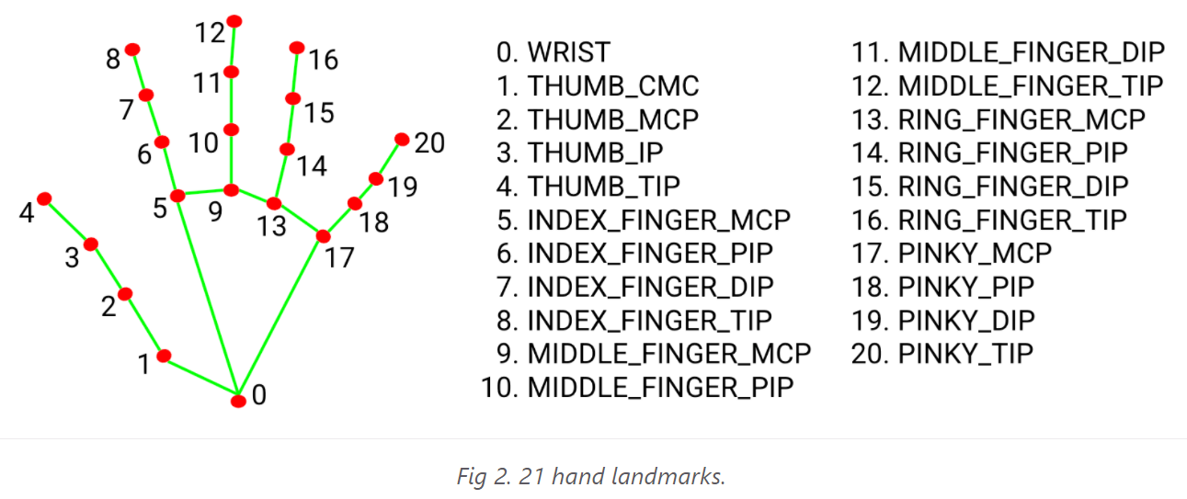
DRY RUN OF ALGORITHM
According to our code it the initial Conv2D layer take live feed image through camera and the final completely linked layer gives us result as like , dislike, forward, right, left output. it train the model according to hand landmark model.
Hand Landmark Model:
After the palm detection over the whole image our subsequent hand landmark model performs precise keypoint localization of 21 3D hand-knuckle coordinates inside the detected hand regions via regression, that is direct coordinate prediction. The model learns a consistent internal hand pose representation and is robust even to partially visible hands and self-occlusions.

Slide 6
DRY RUN OF ALGORITHM
For finger we can easily tell if it is up or down by comparing y coordinate of fingertip landmark and finger pip landmark. for fingers we compare the y coordinate point. TIP point> middle point than finger is above otherwise it is down.
But for the thumb scenario will be different we compare the x coordinate of Thumb TIP landmark and x coordinate of Thumb MCP and condition vary according to right and left hand.
For right hand thumb whenever thumb open x coordinate of THUMB_TIP <THUMB_MCP.

Slide 7
DRY RUN OF ALGORITHM
For left x coordinate of THUMB_TIP>THUMB_MCP
using this concept, we compare the fingers and thumb and find out the result for like ,dislike, etc

Slide 8
TOOLS AND TECHNOLOGIES
Python
Jupyter platform

Slide 9
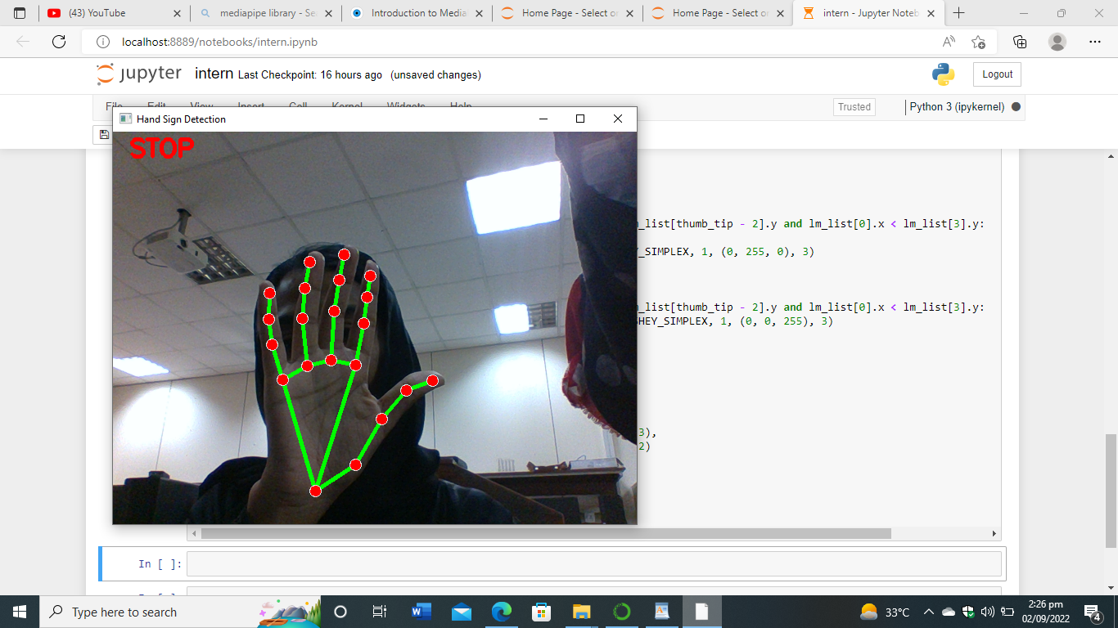
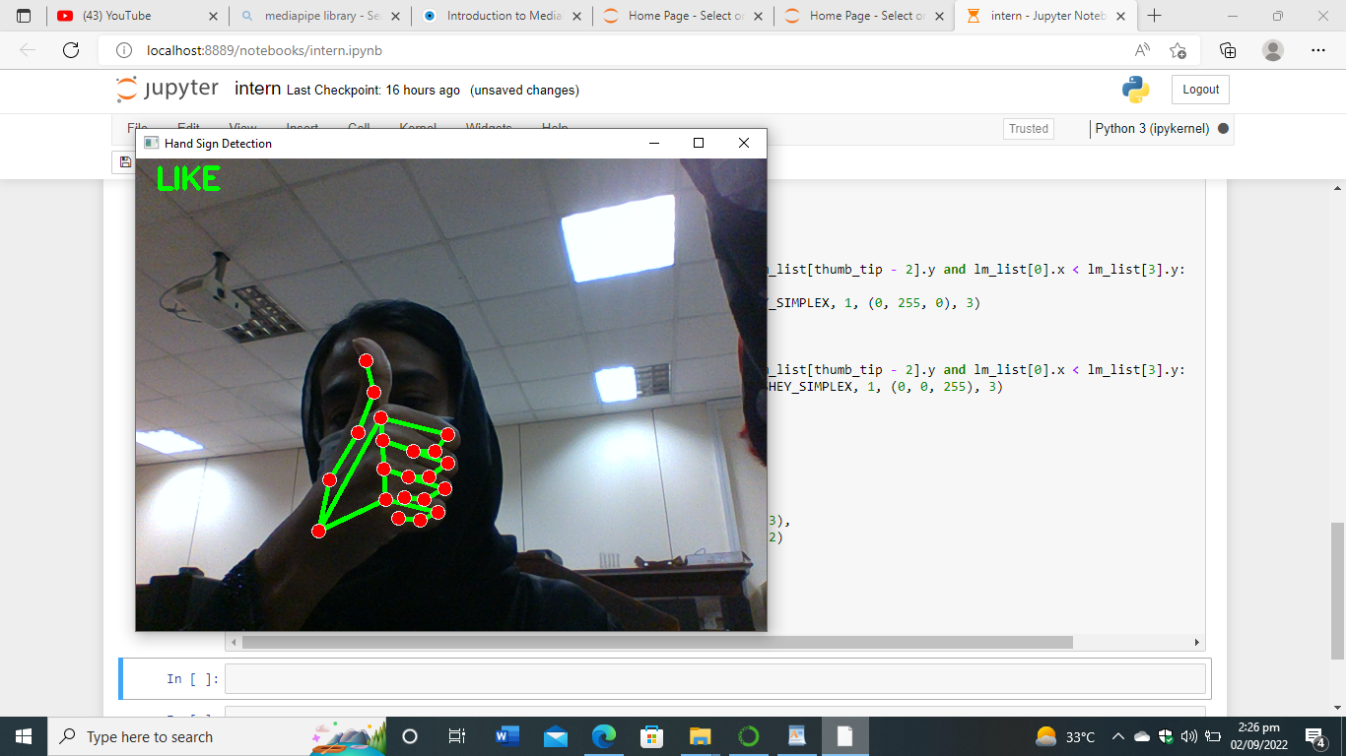
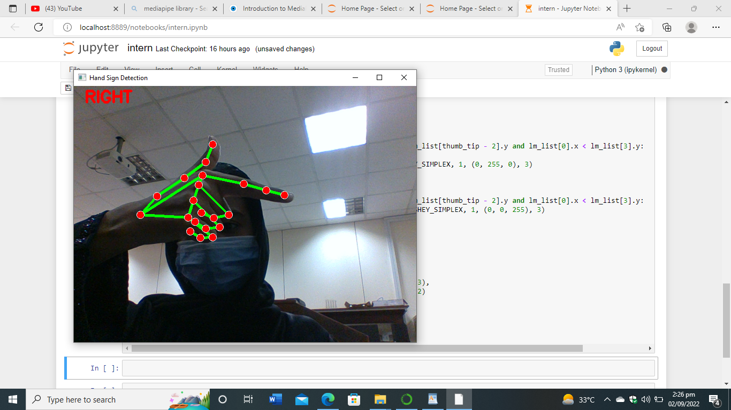
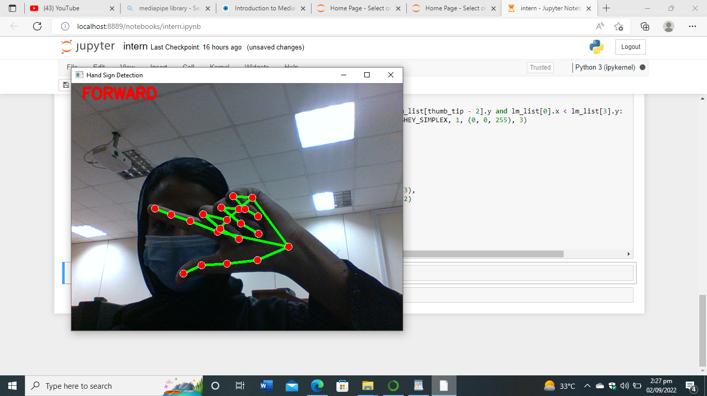
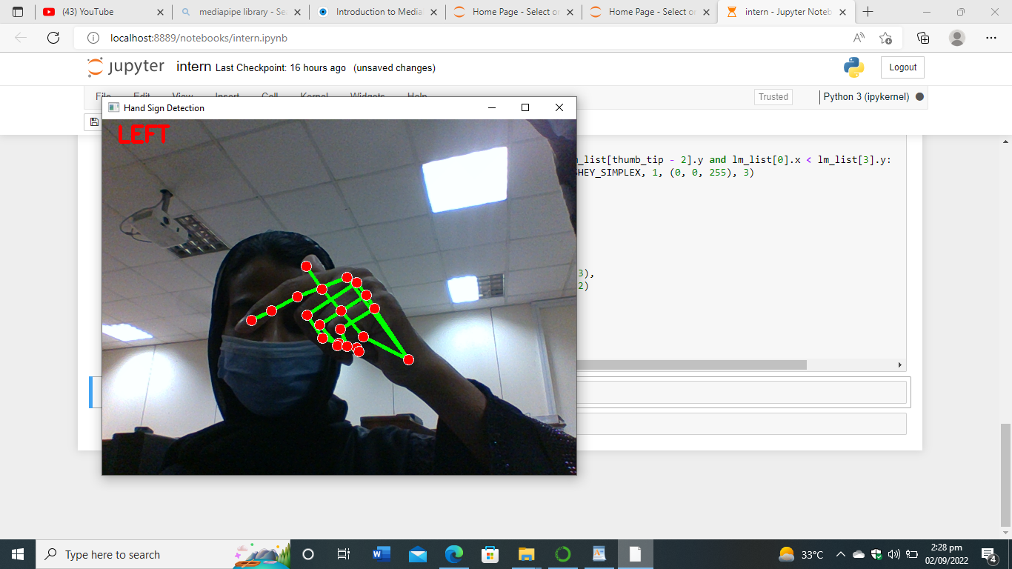
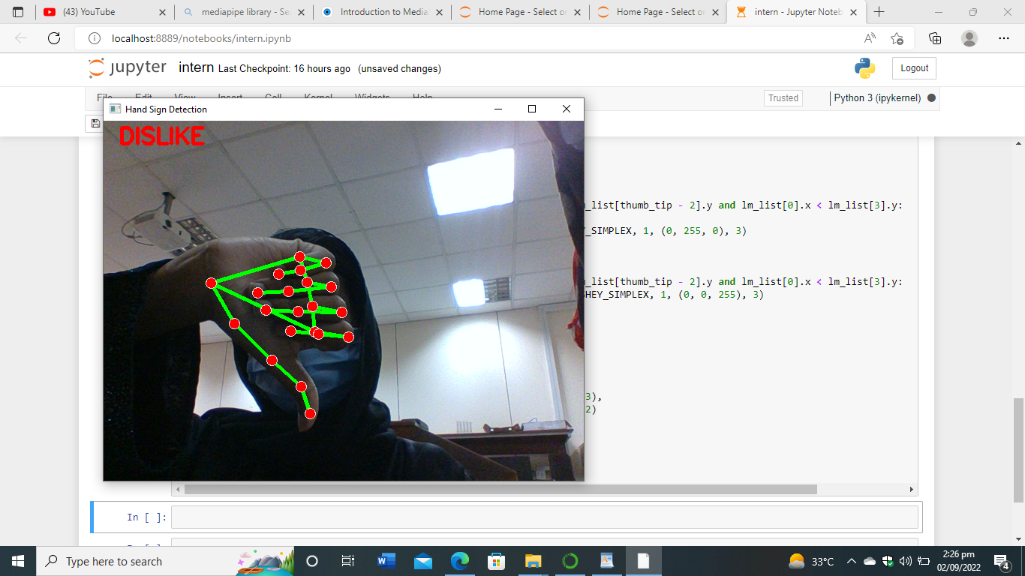
OUTPUT SCREENSHOT

Slide 10
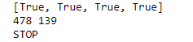
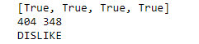
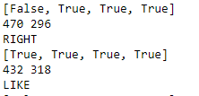
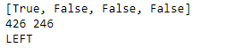
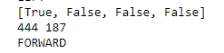
OUTPUT SCREENSHOT

Slide 11
YOUTUBE VIDEO LINK
https://youtu.be/md6y62tmyCw

